Slide 1
NLP Image Captioning
Group 5
Jacinta 206562 Ashraf 196280 Farah 194233 Mohamed 206069

Slide 2
01
02
03
Pre-processing
Modeling
Evaluation
OUTLINE

Slide 3
01
PRE-PROCESSING

Slide 4
PRE-PROCESSING STEPS
imgToCaptions dictionary
basic stopwords removed
no stemming; should be coherent English
8k images * 5 captions * 7 words ≈ 280k words
vocab of words
function to limit words by frequency threshold
full vocab ≈ 8k words
>= 5 occurring words ≈ 3k words
wordToIdx dictionary
prefix, suffix words to each caption
Google’s InceptionV3 to produce feature vector of size 2048 (passed to NLP model)

Slide 5
MODEL ARCHITECTURES
02
LSTM + GRU

Slide 6
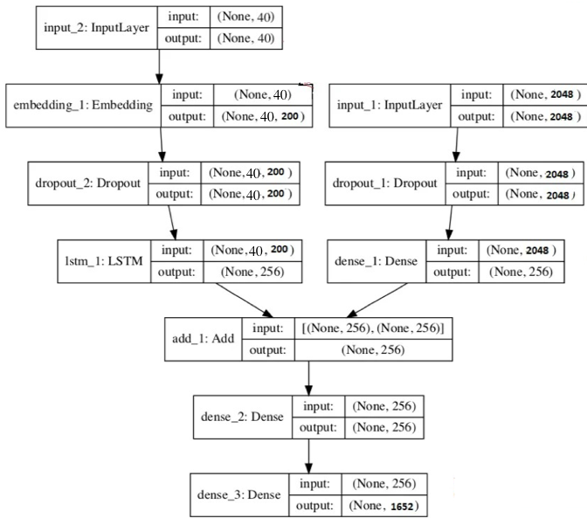
ARCHITECTURE AND HYPERPARAMETERS
Hyperparameters
Inception v3 with imagenet weights
Frequency threshold = 5
Batch size = 32
Epochs = 30
Embedding dimensions = 200
Dropout rate = 0.5
Dense layer units = 256
Hidden layer activation = relu
Output layer activation = softmax
Second Model
Likewise, with GRU instead of LSTM

Slide 7
MODEL EVALUATION
03
ROUGE + BLEU

Slide 8
0.01695 | 0.01569
0.19144 | 0.17871
Average BLEU Score (LSTM | GRU)
Average ROUGE Score (LSTM | GRU)

Slide 9
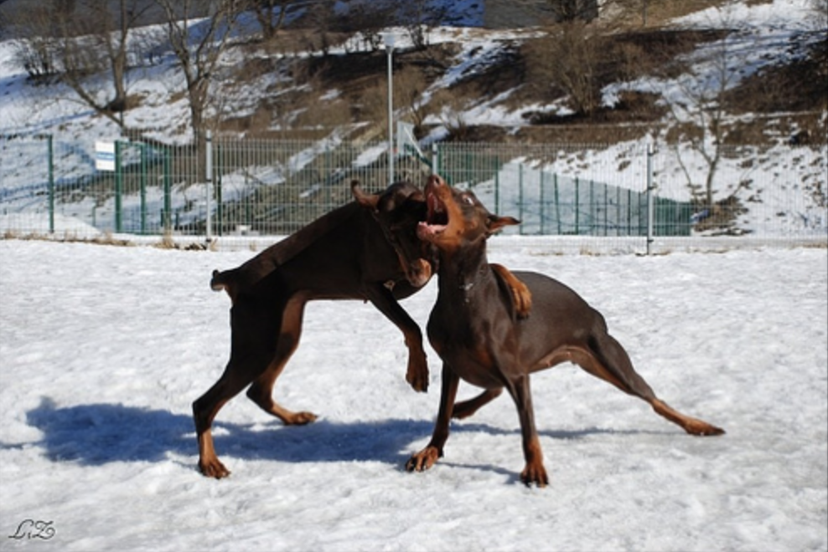
LSTM: startseq brown dog is biting a stick on the snow . a dog . is biting a toy . his mouth . . it is laying on the grass . . a dog . . . . . . . .
GRU: startseq dogs are running in a grassy area . a wooded area . a fence . . grabbing . . . . . seen . . seen . . seen . . seen . . seen . . seen . .

Slide 10
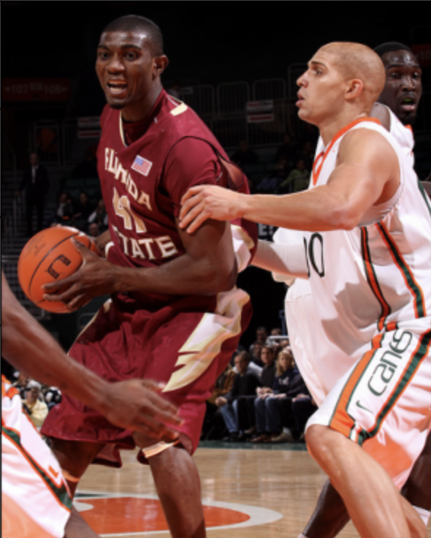
Highest BLEU
Produced by: LSTM Model (0.2336)
Output Caption:
“startseq basketball player in a white uniform is trying to score . the player in white . the ball . the ball . the ball . . . . . . . . . . . . . . . ."

Slide 11
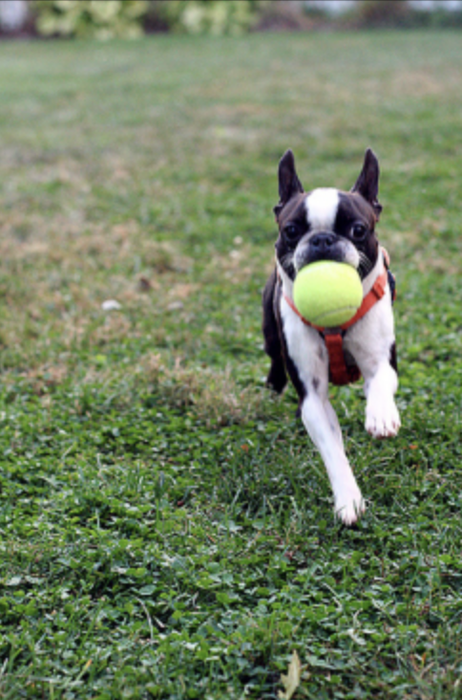

Highest ROUGE
Produced by: GRU Model (0.4333)
Output Caption:
“startseq black and white dog with a blue collar is running through a field . with a stick in its mouth . a second . a blue strip . its mouth . . . . . . . . . .”

Slide 12
THANK YOU

